Slide 2
404 Errors in ASP.NET Core
public ViewResult Details(int id)
{
Employee employee = _employeeRepository.GetEmployee(id);
if (employee == null)
{
Response.StatusCode = 404;
return View("EmployeeNotFound", id);
}
return View(employee);
}
404 Not Found View Code
@model int
@{
ViewBag.Title = "404 Error";
}
<div class="alert alert-danger mt-1 mb-1">
<h4>404 Not Found Error :</h4>
<hr />
<h5>
Employee with ID = @Model cannot be found
</h5>
</div>
<a asp-controller="home" asp-action="index" class="btn btn-outline-success"
style="width:auto">Click here to see the list of all employees</a>
The following URL invokes the Details() action of the HomeController passing it the ID of 99
http://localhost/home/details/99

Slide 3
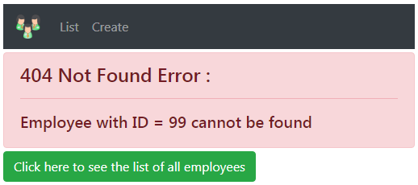
In this case, we know the user is trying to go to the employee details page, but the provided ID value is invalid. So we are returning a custom error page with the message, the ID cannot be found and a link that he could click to see the list of all employees.
Type 2 : The URL does not match any route
Consider the following route. This also results in a 404 error
http://localhost/foo/bar
In this case we are not sure, the page the user is trying to get to so displaying a custom error page is not possible. In this case we want to return a generic error page

Slide 4
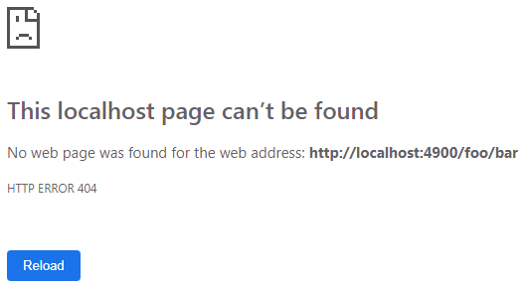
The following is code in Configure() method of Startup class in Startup.cs file. As you might already know, this Configure() method configures the HTTP request processing pipeline for our asp.net core application.
public void Configure(IApplicationBuilder app, IHostingEnvironment env)
{
if (env.IsDevelopment())
{
app.UseDeveloperExceptionPage();
}
app.UseStaticFiles();
app.UseMvc(routes =>
{
routes.MapRoute("default", "{controller=Home}/{action=Index}/{id?}");
});
}
At the moment we do not have anything configured in this http request processing pipeline to handle 404 errors. So if we navigate to http://localhost/foo/bar, we see the following default 404 error page. This is because the URL /foo/bar does not match any routes in our application.

Slide 5
The major purpose of UseDeveloperExceptionPage() is to help the user to inspect exception details during the development phase.
Namespace for the method - Microsoft.AspNetCore.Builder
Purpose of function
To capture Synchronous and Asynchronous SystemException instance from the pipeline & generate HTML error response. It returns a reference to the application after the operation is completed.
We use the UseDeveloperException() extension method to render the exception during the development mode
This method adds middleware into the request pipeline which displays developer-friendly exception detail page. This helps developers in tracing errors that occur during the development phase

Slide 6

Handling non-success http status codes
To handle non-success http status codes such as 404 for example, we could use the following 3 built-in asp.net core middleware components.
UseStatusCodePages
UseStatusCodePagesWithRedirects
UseStatusCodePages Middleware
This is the least useful of the 3 status code middleware components. For this reason, we rarely use it in a real world production application. To use it in an application and see what it can do, plug it into the http processing pipeline as shown below.
if (app.Environment.IsDevelopment()) {
app.UseDeveloperExceptionPage();
}
else
{
app.UseStatusCodePages();
}
app.UseStaticFiles();
app.UseMvc(routes =>
{
routes.MapRoute("default", "{controller=Home}/{action=Index}/{id?}");
});
}
With UseStatusCodePages Middleware configured, if we navigate to http://localhost/foo/bar, it returns the following simple text respons

Slide 7
UseStatusCodePagesWithRedirects Middleware
In a production quality application we want to intercept these non-success http status codes and return a custom error view. To achieve this, we can either use UseStatusCodePagesWithRedirects middleware or UseStatusCodePagesWithReExecute middleware.
public void Configure(IApplicationBuilder app, IHostingEnvironment env)
{
if (env.IsDevelopment())
{
app.UseDeveloperExceptionPage();
}
else
{
app.UseStatusCodePagesWithRedirects("/Error/{0}");
}
app.UseStaticFiles();
app.UseMvc(routes =>
{
routes.MapRoute("default", "{controller=Home}/{action=Index}/{id?}");
});
}
public class ErrorController : Controller
{
// If there is 404 status code, the route path will become Error/404
[Route("Error/{statusCode}")]
public IActionResult HttpStatusCodeHandler(int statusCode)
{
switch (statusCode)
{
case 404:
ViewBag.ErrorMessage = "Sorry, the resource you requested could not be found";
break;
}
return View("NotFound");
}
}
@{
ViewBag.Title = "Not Found";
}
<h1>@ViewBag.ErrorMessage</h1>
<a asp-action="index" asp-controller="home"> Click here to navigate to the home page
</a>
At this point, if we navigate to http://localhost/foo/bar we see the following custom 404 error view NotFound.cshtml as expected.

